Slide 1
CPU
SCHEDULING
HNDIT24012 Computer Architecture

Slide 2
CPU Scheduling
What Is In This Chapter?
This chapter is about how to get a process attached to a processor.
It centers around efficient algorithms that perform well.
The design of a scheduler is concerned with making sure all users get their fair share of the resources.

Slide 3
CPU Scheduling
What Is In This Chapter?
Basic Concepts
Scheduling Criteria
Scheduling Algorithms
Multiple-Processor Scheduling
Real-Time Scheduling
Thread Scheduling
Operating Systems Examples
Java Thread Scheduling
Algorithm Evaluation

Slide 4
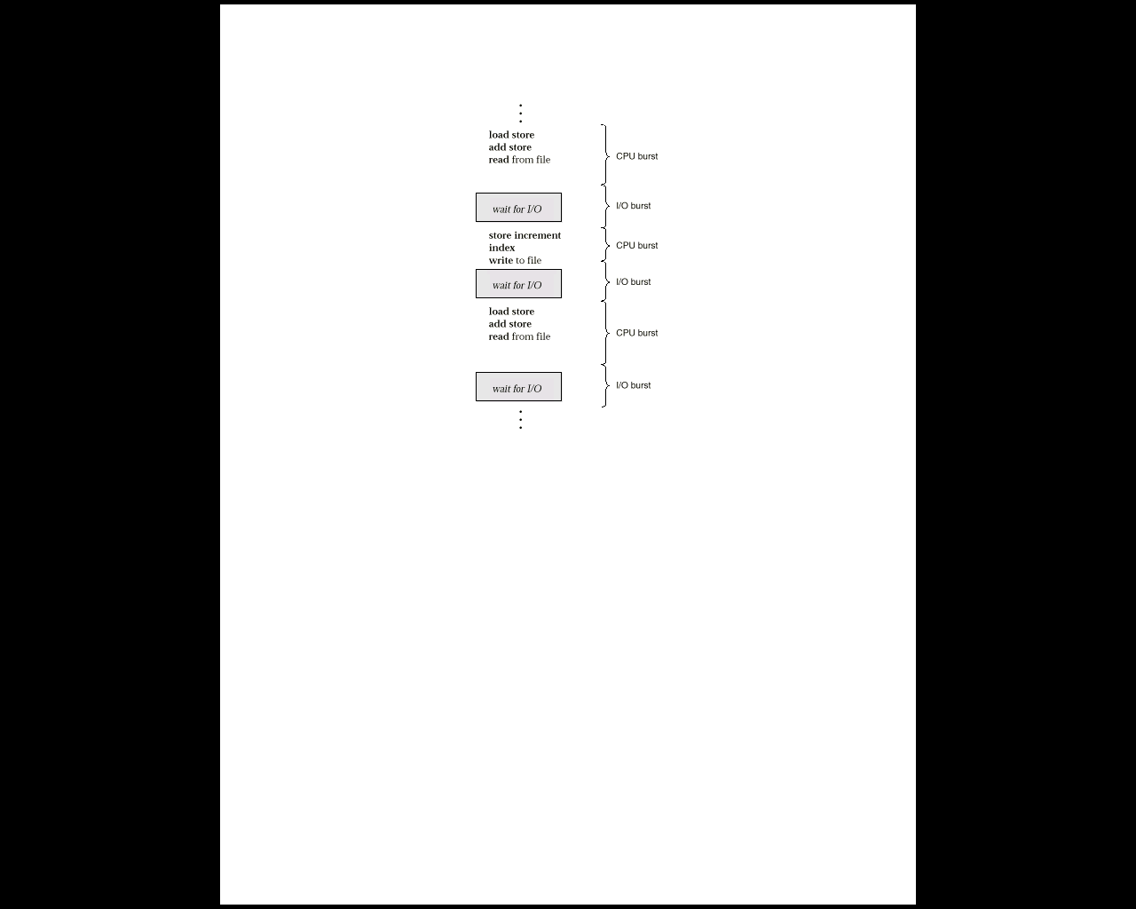
CPU SCHEDULING
Scheduling
Concepts
Multiprogramming A number of programs can be in memory at the same time. Allows overlap of CPU and I/O.
Jobs (batch) are programs that run without user interaction.
User (time shared) are programs that may have user interaction.
Process is the common name for both.
CPU - I/O burst cycle Characterizes process execution, which alternates, between CPU and I/O activity. CPU times are generally much shorter than I/O times.
Preemptive Scheduling An interrupt causes currently running process to give up the CPU and be replaced by another process.

Slide 5
CPU SCHEDULING
The Scheduler
Selects from among the processes in memory that are ready to execute, and allocates the CPU to one of them
CPU scheduling decisions may take place when a process:
1. Switches from running to waiting state
2. Switches from running to ready state
3. Switches from waiting to ready
4. Terminates
Scheduling under 1 and 4 is nonpreemptive
All other scheduling is preemptive

Slide 6
CPU SCHEDULING
The Dispatcher
Dispatcher module gives control of the CPU to the process selected by the short-term scheduler; this involves:
switching context
switching to user mode
jumping to the proper location in the user program to restart that program
Dispatch latency – time it takes for the dispatcher to stop one process and start another running

Slide 7
CPU SCHEDULING
Criteria For
Performance
Evaluation
Note usage of the words DEVICE, SYSTEM, REQUEST, JOB.
UTILIZATION The fraction of time a device is in use. ( ratio of in-use time / total observation time )
THROUGHPUT The number of job completions in a period of time. (jobs / second )
SERVICE TIME The time required by a device to handle a request. (seconds)
QUEUEING TIME Time on a queue waiting for service from the device. (seconds)
RESIDENCE TIME The time spent by a request at a device.
RESIDENCE TIME = SERVICE TIME + QUEUEING TIME.
RESPONSE TIME Time used by a system to respond to a User Job. ( seconds )
THINK TIME The time spent by the user of an interactive system to figure out the next request. (seconds)
The goal is to optimize both the average and the amount of variation. (but beware the ogre predictability.)

Slide 8
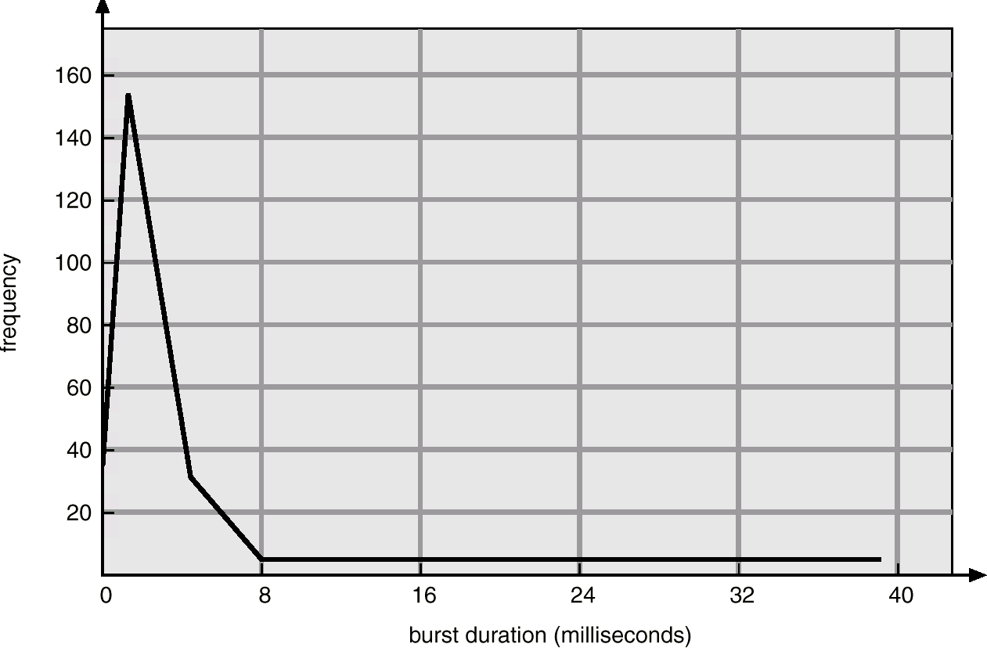
CPU SCHEDULING
Scheduling Behavior
Most Processes Don’t Use Up Their Scheduling Quantum!

Slide 9
CPU SCHEDULING
Scheduling
Algorithms
FIRST-COME, FIRST SERVED:
( FCFS) same as FIFO
Simple, fair, but poor performance. Average queueing time may be long.
What are the average queueing and residence times for this scenario?
How do average queueing and residence times depend on ordering of these processes in the queue?

Slide 10
CPU SCHEDULING
Scheduling
Algorithms
EXAMPLE DATA:
Process Arrival Service
Time Time
1 0 8
2 1 4
3 2 9
4 3 5
FCFS
P1
P2
P3
P4
0
8
12
21
26
Average wait = ( (0-0) + (8-1) + (12-2) + (21-3) )/4 = 35/4= 8.75
Residence Time at the CPU
Average wait = ( (8-0) + (12-1) + (21-2) + (26-3) )/4 = 61/4 = 15.25

Slide 11
CPU SCHEDULING
Scheduling
Algorithms
SHORTEST JOB FIRST:
Optimal for minimizing queueing time, but impossible to implement. Tries to predict the process to schedule based on previous history.
Predicting the time the process will use on its next schedule:
t( n+1 ) = w * t( n ) + ( 1 - w ) * T( n )
Here: t(n+1) is time of next burst.
t(n) is time of current burst.
T(n) is average of all previous bursts .
W is a weighting factor emphasizing current or previous bursts.

Slide 12
CPU SCHEDULING
Scheduling
Algorithms
PREEMPTIVE ALGORITHMS:
Yank the CPU away from the currently executing process when a higher priority process is ready.
Can be applied to both Shortest Job First or to Priority scheduling.
Avoids "hogging" of the CPU
On time sharing machines, this type of scheme is required because the CPU must be protected from a run-away low priority process.
Give short jobs a higher priority – perceived response time is thus better.
What are average queueing and residence times? Compare with FCFS.

Slide 13
CPU SCHEDULING
Scheduling
Algorithms
EXAMPLE DATA:
Process Arrival Service
Time Time
1 0 8
2 1 4
3 2 9
4 3 5
Preemptive Shortest Job First
P1
P2
P4
P1
P3
0
1
5
10
17
26
Residence Time at the CPU
Average wait = ( (5-1) + (10-3) + (17-0) + (26-2) )/4 = 52/4 = 13.0
Average wait = ( 10-1-0) + (1-1) + (5-2) + (17-3) )/4 = 26/4

Slide 14
CPU SCHEDULING
Scheduling
Algorithms
PRIORITY BASED SCHEDULING:
Assign each process a priority. Schedule highest priority first. All processes within same priority are FCFS.
Priority may be determined by user or by some default mechanism. The system may determine the priority based on memory requirements, time limits, or other resource usage.
Starvation occurs if a low priority process never runs. Solution: build aging into a variable priority.
Delicate balance between giving favorable response for interactive jobs, but not starving batch jobs.

Slide 15
CPU SCHEDULING
Scheduling
Algorithms
ROUND ROBIN:
Use a timer to cause an interrupt after a predetermined time. Preempts if task exceeds it’s quantum.
Train of events
Dispatch
Time slice occurs OR process suspends on event
Put process on some queue and dispatch next
Use numbers in last example to find queueing and residence times. (Use quantum = 4 sec.)
Definitions:
Context Switch Changing the processor from running one task (or process) to another. Implies changing memory.
Processor Sharing Use of a small quantum such that each process runs frequently at speed 1/n.
Reschedule latency How long it takes from when a process requests to run, until it finally gets control of the CPU.

Slide 16
CPU SCHEDULING
Scheduling
Algorithms
ROUND ROBIN:
Choosing a time quantum
Too short - inordinate fraction of the time is spent in context switches.
Too long - reschedule latency is too great. If many processes want the CPU, then it's a long time before a particular process can get the CPU. This then acts like FCFS.
Adjust so most processes won't use their slice. As processors have become faster, this is less of an issue.

Slide 17
CPU SCHEDULING
Scheduling
Algorithms
EXAMPLE DATA:
Process Arrival Service
Time Time
1 0 8
2 1 4
3 2 9
4 3 5
Note:
Example violates rules for quantum size since most processes don’t finish in one quantum.
Round Robin, quantum = 4, no priority-based preemption
P1
P2
P3
P4
P1
P3
P4
P3
0
4
8
12
16
20
24
25
26
Residence Time at the CPU
Average wait = ( (20-0) + (8-1) + (26-2) + (25-3) )/4 = 74/4 = 18.5
Average wait = ( (16-4-0) + (4-1) + (25-24+20-12+8-2) + (24-16+12-3) )/4 =

Slide 18
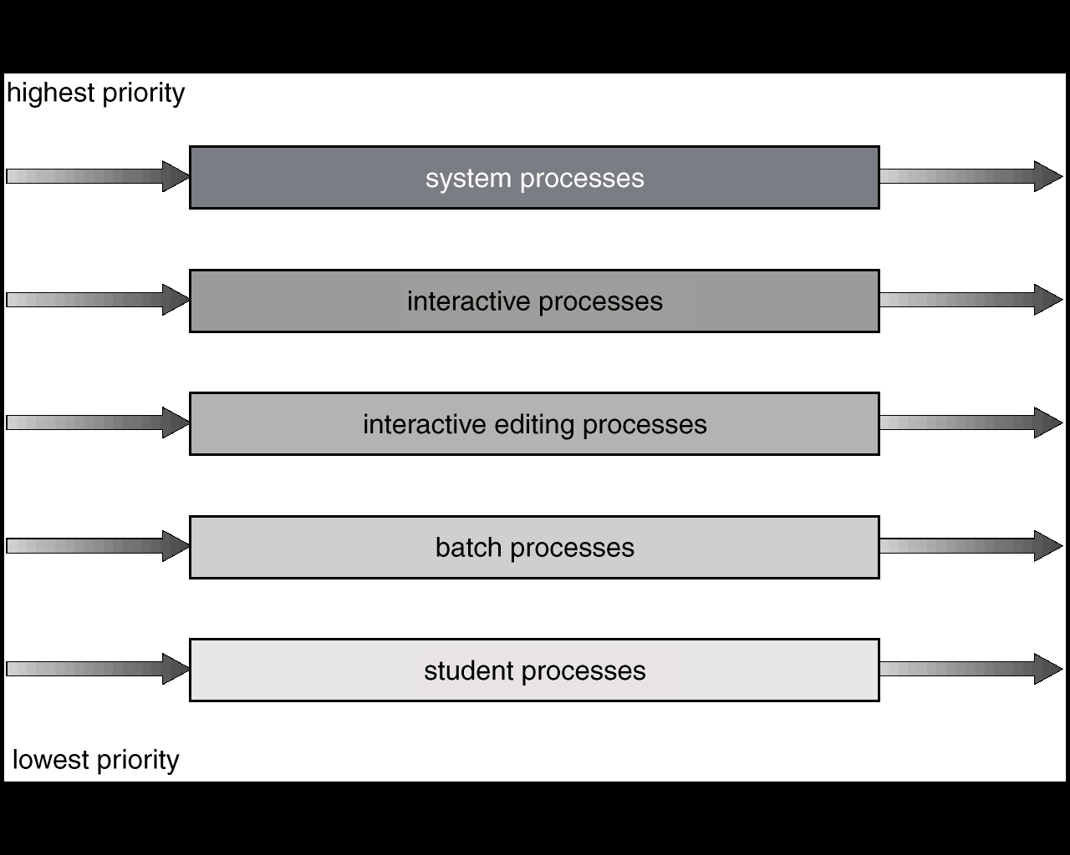
CPU SCHEDULING
Scheduling
Algorithms
MULTI-LEVEL QUEUES:
Each queue has its scheduling algorithm.
Then some other algorithm (perhaps priority based) arbitrates between queues.
Can use feedback to move between queues
Method is complex but flexible.
For example, could separate system processes, interactive, batch, favored, unfavored processes

Slide 19
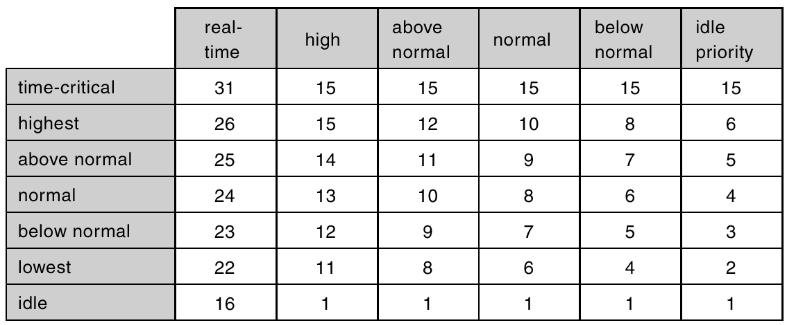
CPU SCHEDULING
Using Priorities
Here’s how the priorities are used in Windows

Slide 20
CPU SCHEDULING
Scheduling
Algorithms
MULTIPLE PROCESSOR SCHEDULING:
Different rules for homogeneous or heterogeneous processors.
Load sharing in the distribution of work, such that all processors have an equal amount to do.
Each processor can schedule from a common ready queue ( equal machines ) OR can use a master slave arrangement.
Real Time Scheduling:
Hard real-time systems – required to complete a critical task within a guaranteed amount of time.
Soft real-time computing – requires that critical processes receive priority over less fortunate ones.

Slide 21
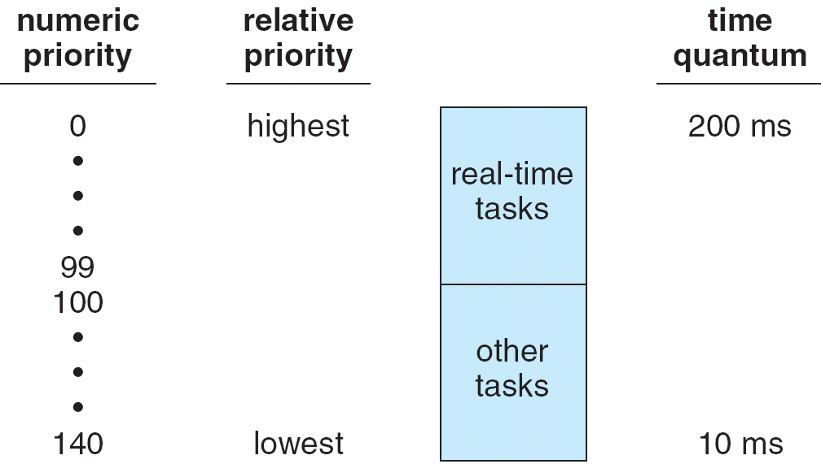
CPU SCHEDULING
Linux Scheduling
Two algorithms: time-sharing and real-time
Time-sharing
Prioritized credit-based – process with most credits is scheduled next
Credit subtracted when timer interrupt occurs
When credit = 0, another process chosen
When all processes have credit = 0, recrediting occurs
Based on factors including priority and history
Real-time
Soft real-time
Posix.1b compliant – two classes
FCFS and RR
Highest priority process runs first

Slide 22
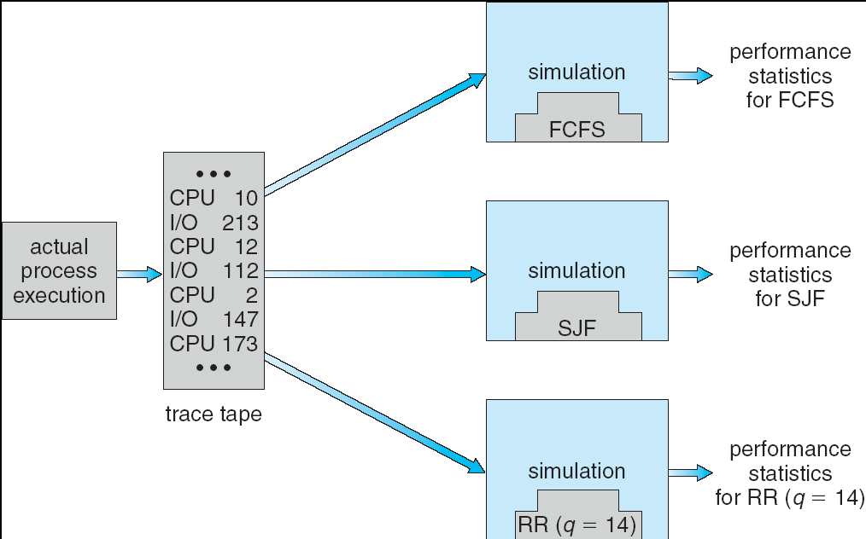
CPU SCHEDULING
Algorithm Evaluation
How do we decide which algorithm is best for a particular environment?
Deterministic modeling – takes a particular predetermined workload and defines the performance of each algorithm for that workload.
Queueing models.

Slide 23
CPU SCHEDULING
WRAPUP
We’ve looked at a number of different scheduling algorithms.
Which one works the best is application dependent.
General purpose OS will use priority based, round robin, preemptive
Real Time OS will use priority, no preemption.

